Slide 1


MODULE- 9
JSP

Slide 2
Course Topics
→ Module 1
» Introduction to Java
→ Module 8
» Servlets
→ Module 2
» Data Handling and Functions
→ Module 9
» JSP
→ Module 3
» Object Oriented Programming in Java
→ Module 10
» Hibernate
→ Module 4
» Packages and Multi-threading
→ Module 11
» Spring
→ Module 5
» Collections
→ Module 12
» Spring, Ajax and Design Patterns
→ Module 6
» XML
→ Module 13
» SOA
→ Module 7
» JDBC
→ Module 14
» Web Services and Project

Slide 3

Objectives
At the end of this module, you will be able to
→ Understand JSP page
→ Learn to write a JSP page
→ Understand implicit objects available in JSP page and JSP page directives
→ Learn about cookies and session handling
→ Learn about JSP standard actions, JSTL and custom tags

Slide 4
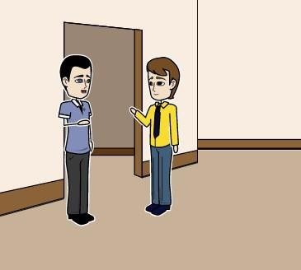
Mark Greets John
Hi John!!
Hi Mark….How
are u?

Slide 5
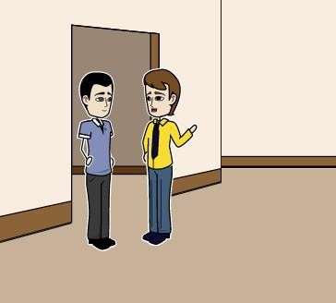
Mark has a doubt
I need some help from you. Can we talk for a while..

Slide 6

John helps Mark
Sure Mark!!!

Slide 7
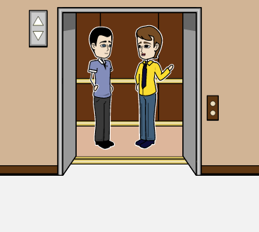
John helps Mark
Can we generate dynamic content through HTML?

Slide 8
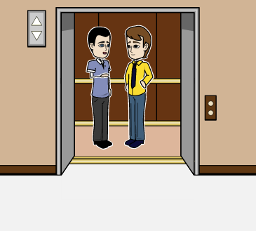
John helps Mark
We can use Java with HTML. The
page is called JSP.
Lets Learn More….

Slide 9
What is JSP?
→ JSP Stands for Java Server Pages.
→ JSP will have the extension of .jsp.
→ Like servlet, jsp file has to be executed on web server or app server.
→ HTML + Java is jsp. That means a JSP file will have both HTML and Java code.
→ JSP is used for UI/front end/display purpose.

Slide 10









JSP Execution Procedure
A JSP will be converted to a servlet file. The servlet file is compiled and generates a .class file. This .class file is loaded into memory and executed by JVM as usual.
hello.jsp
Translation
phase
1. GET/hello.jsp
3. Generate
Client
Server with JSP container
hello_jsp.java
6. HTTP/1.0 200 DK
4. Compile
Request processing phase
hello_jsp.class

Slide 11







JSP Execution Procedure (contd.)
JSP
Buffer (dynamic content)
JSP
Translator
Servlet object
Servlet (.java file)
Java
Compiler
JRE
Class file

Slide 12




Advantages of JSP over HTML
User need not write HTML and Java code separately.
JSP can be used for both front end and for writing business
logic/middle later.
JSP is very easy to write when compared to Servlets.
Middle Tier Server
business rules
Data Server
business data
JSP is dynamic compilation, which means when a JSP is modified, it need not be compiled and restarted in the web server. After the modification of JSP, refresh the browser, changes will be reflected.
Data Server
In many applications only JSP is used for first two tiers of 3 tier architecture, which is also called 2 tier architecture. Going forward in frameworks like struts and spring, MVC is used which is same as 3 tier architecture. MVC stands for Model View controller.
Client
presentation logic
Model is data. View is for display and controller – is a centralized controller which says what the application has to do.

Slide 13

Annie’s Question
What is 3 tier architecture and why do we need it?

Slide 14
Annie’s Answer
In 3 tier architecture we have Presentation Tier which represents information to the user, Logic Tier here we make logical decisions and perform basic computation. It is the Logic tier which transfers data between Presentation Tier and Data Tier where information is stored. 3 tier architecture increases performance, scalability, flexibility and maintainability.

Slide 15





JSP Life-Cycle
JavaServer Page
jsplnit() (Load Resources)
Like in servlet init(), service() and destroy(), jsp
also has jspinit(), _jspService(), jspdestroy().
Request
Response
_jspService()
(Accept Requests)
Same as servlet, when jspInit() is called when jsp is loaded in memory. _jspService() is called when the client requests and jspDestroy() is invoked when jsp is removed from memory.
jspDestroy()
(Unload Resources)

Slide 16
JSP Files Execution Procedure
All the jsp files will be written under WebContent directory of Eclipse.
→ In eclipse, for executing a jsp, select the jsp and right click on it and click on “Run As →
Run on Server”. Jsp file will be executed by opening the default browser.
→ User can select the internal browser for displaying the jsp by selecting “window menu → Web Browser → Internal Browser”. The advantage of selecting internal browser is, all the time we need not shuffle between external browser and the program if there are any modifications in the program.
→ Once the complete code is developed, then for final testing external browser can be used to see the result.

Slide 17
JSP Tags
There are three tags in jsp. They are
Scriptlet → For writing Java code.
Declarative → For declaring attributes and methods.
Expression → For displaying data.

Slide 18

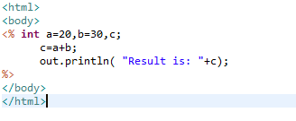
Scriptlet tag
Scriptlet tag is represented by <% %>
Java code should be embedded in this scriptlet tag.
Here Java code is embedded inside the scriptlet tag. When this code is executed 50 is displayed on the browser.

Slide 19

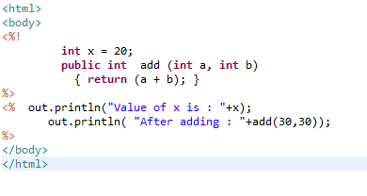
Declaration Tag
Declaration tag is used to define attributes and methods in a jsp file. Declaration tag is represented by <%! %>
One exclamation symbol has to be added in scriptlet tag.
Example of declaration tag is:
This code will display value of x is 20 and after adding: 60 on browser.

Slide 20
Expression Tag
→ Expression tag is represented by <%= %>
→ Expression tag is used to display the values.
→ It is equivalent to <% out.println (“”); %>
<%! int x = 20; %>
<%= ("Value of x is : " + x) %>
This will print Value of x. The value of x is 20.

Slide 21
Implicit Objects
Implicit objects are by default available in jsp file. There are 9 implicit objects:
out → Used to print.
request → Used to get the client request information.
response → Used to send the client response.
exception → Used for exception handling.
config → Used to read configuration param of web.xml
application → Used to read configuration param for the whole application.
session → Use to set and read values in session.
pageContext → Can set the values of variable in a scope of page, request, session and application. page → This is equivalent to object and just replaced with this object.

Slide 22
Implicit Object – out
In the previous examples, we have used out object to print the data.
out.println (“Value of is x : “ + x);
It is same as getting PrintWriter object in servlets from response object and writing using this object to the client.
out object is implicitly available to all jsp files. So we don’t have to write response.getWriter() as we do in case of servlets.

Slide 23


Implicit Object – request
Request object is used to read the client's input.
Above code will retrieve the name parameter from the request scope. If there is no parameter
named “name” in request scope you will get null.

Slide 24

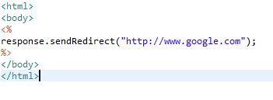
Implicit Object – response
It is same as request.
request will get the client input and response object is used to send the response back to the client.
This will redirect the response object to google.com. By executing the above code, browser will display google.com web page.

Slide 25
Implicit Object – pageContext
In web, there are 4 types of scope for a variable. They are
→ page – Variable is only available in that JSP page.
→ request – Variable is available in entire request.
→ session – Variable is available in the entire session.
→ application – Application variables are available across all the sessions .

Slide 26

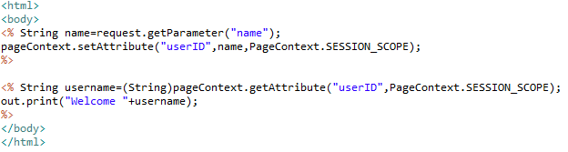
Implicit Object – pageContext
→ In the first section we are retrieving the value of name parameter that was previously set in request scope. Then we are setting that value in the session scope with the attribute name user ID. If there is no parameter named “name” in request scope you will get null.
→ In the next section we are retrieving the value of attribute user ID that we set in first section.
→ Since the user ID attribute is set in session scope, the value of user ID attribute can be obtained by any jsp file/servlet file in the session.

Slide 27

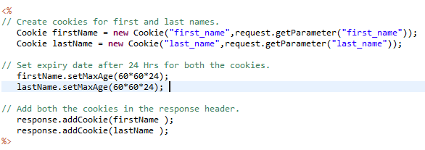
Cookies
Cookies are used to track the user information. Small piece of information about the client is written on the client’s browser which is sent to server on subsequent request.
In above code we are creating two cookies first_name and last_name which have been set to value as given by request parameters. Then we are setting the time limit for which cookies must be stored on client’s machine and in last two lines we are adding cookies on client’s machine.

Slide 28

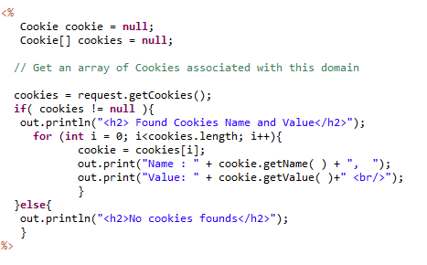
Accessing Cookies
In above code, first we are retrieving cookies and saving it in an array.
Then if there is even a single cookie, we iterate over it and prints its name and value.

Slide 29

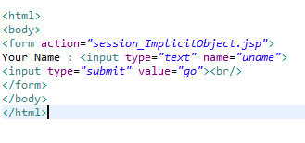
Handling Sessions
Http is a stateless protocol, it means it does not have any way to figure out that the second request is made by the same person who made the first request. So how do we do that?
Two ways of handling sessions:
→ Cookies
→ URL Rewriting
This is the first page where we are asking user’s name.

Slide 30

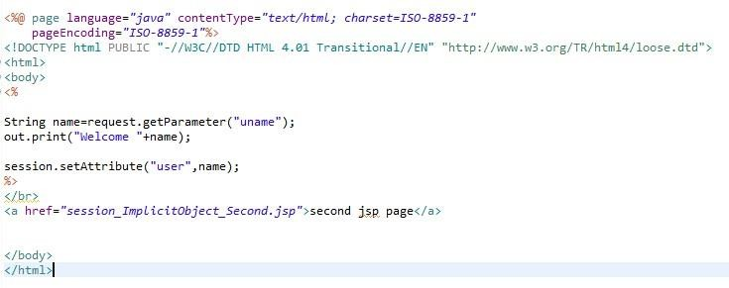
Handling Sessions
Here we are retrieving the value of uname parameter and setting it as a session attribute user.

Slide 31

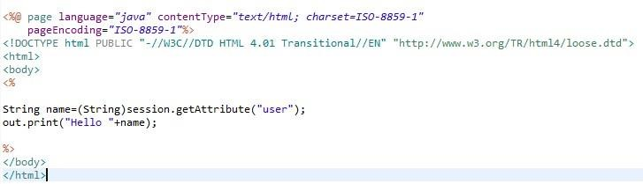
Handling Sessions
Now we are retrieving the value of user session attribute and showing a customized hello message.

Slide 32
Implicit Object – Session
Session object can be directly used incase if the attribute needs to be set in the session scope.
It can be used as:
session.setAttribute("username","edureka");
In the above example, username attribute has been explicitly set to edureka in the session.
username for the session in any other file can be obtained by using
session.getAttribute(“username”);

Slide 33


Implicit Object – exception
→ With this object, exceptions can be handled in jsp.
→ In Java try..catch blocks are used to handle the exception.
→ Specify which jsp file to be executed when there is an exception by using errorPage.
→ exception implicit object is used to print the stacktrace in the errorPage.

Slide 34
JSP - Directives
JSP Directives help the web container to convert the directive into its corresponding servlet.
There are 3 types of directives:
Page directive
include directive
Tag lib directive

Slide 35
Page Directive
Page directive can set the attributes for the current JSP page.
Page directive has many attributes. They are as follows:
buffer → Can set the buffer size of the page.
import → Imports the Java or package file. This is similar to import statement in Java.
contentType → Set the response content Type. It could be HTML/text/DOC etc. extends → Specifies the superclass for the servlet when generated.
info → Used to give the information about the jsp page and it will be written into getServletInfo() when converted to servlet.

Slide 36

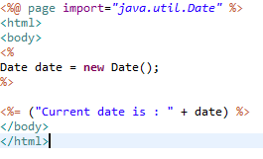
Page import Directive
This code will import java.util.Date and displays today's date.

Slide 37
JSP include Directive
JSP include directive will include the specified resource at conversion time.
Html/jsp file can be included. Syntax is:
<%@ include file=”footer.html” %>
All the lines of file footer.html will be included where @include is added.

Slide 38
Annie’s Question
What is the advantage of include directive?

Slide 39
Annie’s Answer
Instead of repeating the same set of code, one file can be written and it can be included in many places. This is called code re- usability.

Slide 40
JSP taglib Directive
This taglib directive will be discussed during JSTL (JSP Standard Tag Library) in coming slides.

Slide 41




Expression Language (EL)
Expression language(EL) is introduced in JSP 2.0. The main purpose of EL is to simplify the process of accessing data from bean properties and from implicit objects.
Without EL
With EL
Other great feature El provides is that it handles null gracefully.
So if in the above code if there is no parameter named “name” have been set then first code snippet will show null while El shows nothing.

Slide 42
JSP – Action tags
There are JSP action tags which performs the specific tasks.
Some of the tags are:
jsp:include → Includes the resource at run time not at compile time. jsp:forward → Forwards the control to another page.
jsp:useBean → Uses bean class.
jsp:setProperty → Sets the property of the bean class.
jsp:getProperty → Retrieves the value of the property from the bean class.

Slide 43


JSP action tag – include
Include action tag can be included as:
This will include dynamicContent.jsp at run time.

Slide 44
Annie’s Question
What is the difference between jsp include directive and jsp include action tag?
When do you use directive or action tag?

Slide 45
Annie’s Answer
Directive is at compile time and action tag is at run time. When static code is required to be included like HTML, use directive and when dynamic code is required like JSP, use action tag.

Slide 46


JSP action tag – forward
When this tag is executed control moves to forwardAction.jsp

Slide 47

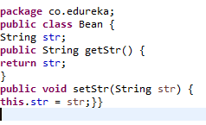


JSP action tag – useBean
Bean Class
JSP Page

Slide 48
UseBean
Java bean is a Java class which has getter and setter methods to retrieve and set the values
of the attributes.
In the example, bean class has str as the string attribute.
In the jsp file, useBean tag is used to access this bean class and setProperty() method is used
to set the attribute str and getProperty is used to get the attribute value.

Slide 49
JSP and JDBC
JSP also can interact with JDBC as in Java.
JSP needs to include jdbc driver from corresponding database vendor. All the steps of the JDBC in JSP is same to interact with the database.
Steps are:
→ Load the driver
→ Get the connection to the database
→ Create a statement
→ Execute the statement
→ Close the connection

Slide 50

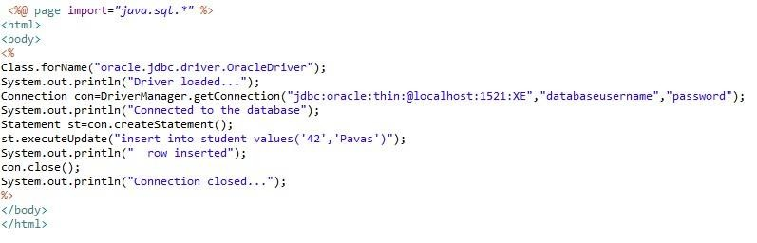
JSP and JDBC

Slide 51




JSTL
JSTL Stands for JSP Standard Tag Library.
This is similar to
Instead of writing in a scriptlet, tags can be used to get the same functionality.

Slide 52
Custom tags
There are cases when JSTL is not enough, we want the JSP tag to do specific things to
achieve our requirement. We can create custom tags like <my:headerTag>
Three files are required to create custom tags.
Java file → What to do when a tag is called.
Tld file → Tag library descriptor file. This file maps the tag name and the Java file to be executed. It is like web.xml which maps URL pattern to servlet class.
Jsp file → File which uses the tag.

Slide 53
Page Directive (contd.)
language → The language used in the jsp. Java/Java Script etc. isELIgnored → Specifies when the expression language is ignored or not. isThreadSafe → Specifies the jsp page is thread safe or not.
autoFlush → Automatically output buffer will be flushed.
session → Specifies whether this page uses HTTPSession object or not.
errorPage and isErrorPage → Used in exception handling in jsp.

Slide 54
LAB

Slide 55

QUESTIONS

Slide 56

Assignment
→ Develop a login screen which has user id and password fields and a submit button.
On clicking the submit button, the user’s information should be sent to the server and authenticate the user’s credentials by checking with the database table user_pass. If the valid user id and password is given then display the message “valid user” else display the invalid user id/password and include the login screen again.

Slide 57

Agenda of the Next Class
In the next class, you will be able to
→ Understand Hibernate and how to use hibernate in eclipse.
→ Create an application using Hibernate
→ Map tables using Hibernate
→ Understand inheritance in hibernate and hibernate cache mechanism.

Slide 58

Pre-work
Practice the following to understand the concepts better in the next class:
→ Practice all programs on JDBC given in earlier modules.
→ Repeat and revise all the Java concepts like Inheritance, Collections which we have covered in earlier classes.

Slide 59
Survey
Your feedback is important to us, be it a compliment, a suggestion or a complaint. It helps us to make
the course better!
Please spare few minutes to take the survey after the webinar.
www.edureka.in/hadoop

Slide 60



